Slide 1
Store Database Insights and Analytics
By Lawrence Isung

Slide 2
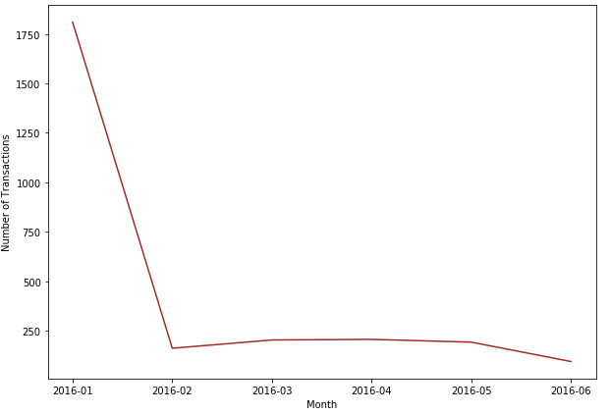
Sales Trend and Seasonality
We will now find out what month in the year has the highest sales, this would be from the transactions' dataset. Although based on the time frame of the transactions' dataset (Jan - July 2016), it does seem like a small sample size to provide predictive analysis for forecasting. However, it is worth checking to see which months the store performed best in sales.
Based on the data available, January 2016 seem to be by far the most productive month in terms of sales and the overall sales showed a downward trend of sales. The store would have to further investigate why sales are not compared or close to January sales, either marketing & advertising measures are not as effective or the goods sold in the store January are seasonal (winter, autumn etc) hence why the spike during those times.

Slide 3
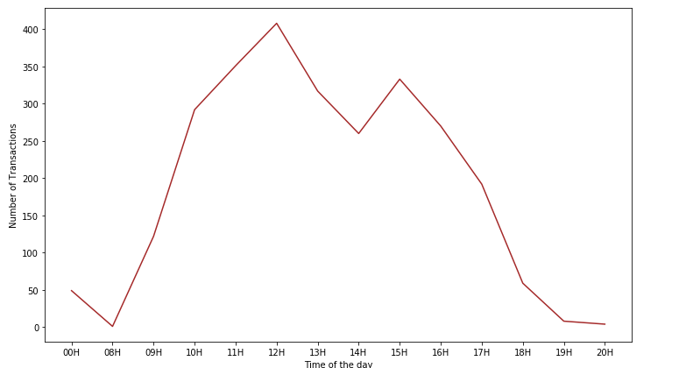
Time Allocation of Employees
Based on the transactions' dataset, we can confirm what time most purchases are made and the time of day with the worst sales.
Based on the results of the analysis, you cannot confirm the hours of operations because of the transactions at 12AM. However this would help in the scheduling of employees' shift, in order to maximize sales and improve customer satisfaction would be have sufficient employees during peak periods and avoid long queues. The store manager can make the necessary changes as the time gets late. Also seems transactions after 9PM are non-existent based on this, it is advisable to make that the closing time to avoid losses.

Slide 4
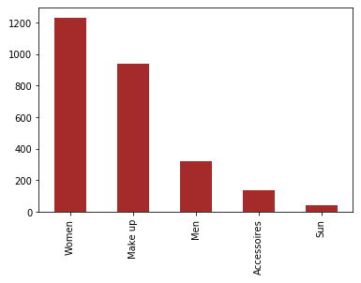
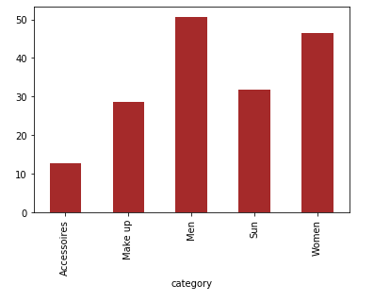
Customer and Products Insights
Highest products sold are from the Women and Make Up category which consists of 81.35% of the total number of transactions of the entire store.
Highest revenue generating category is the Women, next to Make up. In a custom metric, revenue generated per transaction for each category shows that the Men category provide more revenue per transaction (mean). However that's because the average price of an item in the Male category is slightly higher than the Women category but however based on the information provided I would say it is profitable to still have a men's category within the store based on this however an inventory record showing the number of each product and its sale price would clarify that.
According to the data, the active segment that provides the most revenue is the VIP followed by INFREQUENT and the lowest are the NEW customers. This can help provide insights regarding the group to improve marketing strategies on and how to go about it, such as loyalty bonuses, VIP discounts etc.

